Slide 1

Develop the Oracle of DSCOVR
Explore everything and everywhere

Slide 2
PROBLEM
There is a huge DSCOVR dataset, which contains many csv-files with information about the strength and speed of the solar wind in space.
There is no tool to nonlinear forecasting DSCOVR dataset features.
There is no software to forecasting automatically a features DSCOVR dataset.
The main task
is to develop a program for forecasting components of the magnetic field vector and a "raw" measurement spectrum from the Faraday cup plasma detector.

Slide 3

Our idea
Python program for working with scv-files DSCOVR dataset. It prepare dataset for forecast, training neural network, and outputs the result forecast.

Slide 4
algorithm
The specified csv-file reading
Set time delay for forecasting
Set maximum length sequence for forecasting
Select feature number for forecasting
Prepare dataset for forecasting
Split dataset on train and test dataset
Create Elman neural network structure
Select training algorithm and loss function
Output information about Elman neural network structure
Fitting Elman neural network on training dataset
Evaluate Elman neural network on test dataset
Forecasting on based Elman neural network
Plotting forecast dataset and source dataset

Slide 5
For example,
if the delay is 4, hidden neurons is 64, a new neural network for forecast will be created.

Slide 6
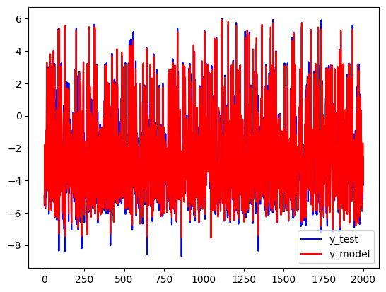
For example,
if the first feature , a forecast for the first 10000 samples will be created

Slide 7
uniqueness and advantages
Automating the forecast process for features DSCOVR dataset
Can training nonlinear forecast model
Can use any time delay for forecast
Can use any feature for forecast
Plotting result forecast

Slide 8
Program’s link:
https://github.com/fedorovee75/Hackathon2023/blob/main/hackathon2023.py

Slide 9

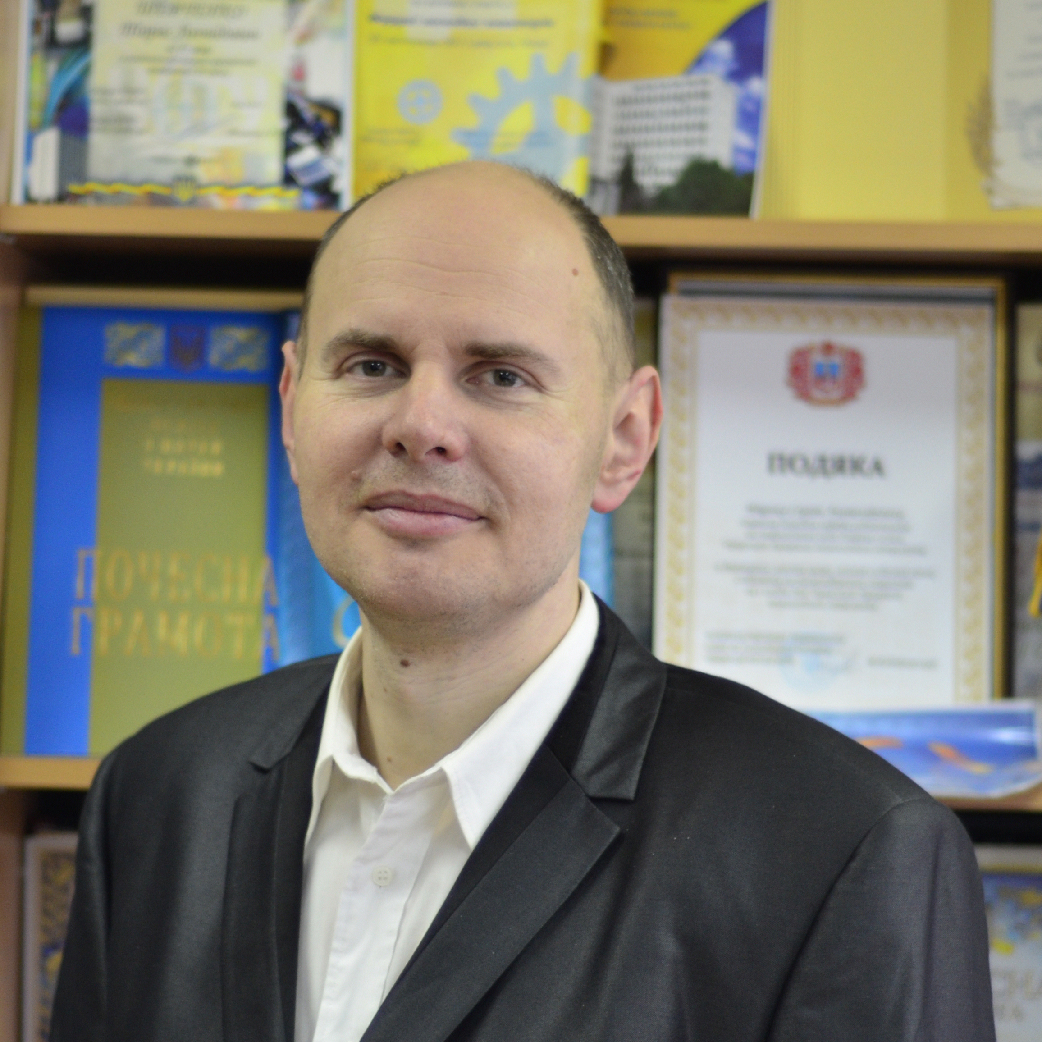
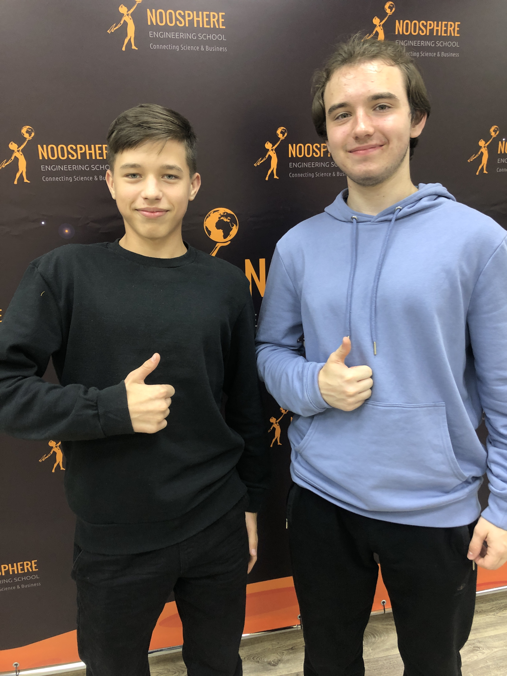
Our team
Eugene Fedorov,
DScTech, Professor
AI/ML Scientist
Vladyslav Petrenko
Semashco Roman

